Slide 1

Stochastic processes
DR\ Amr Amin

Slide 2
Team members
Name | ID
Wesam Fathy Masoud Omar | 20221451271
Nourhan Mohamed Fathy | 20221452411
Mirna Samir Mohamed | 20221450912
Shahd Ahmed Saad Amin | 20221452998
DR\ Amr Amin

Slide 3
Hidden Markov Model(HMM)
INTRODUCTION
is a statistical model that can be used to describe the evolution of observable events that depend on internal factors, which are not directly observable. We call the observed event a `symbol' and the invisible factor underlying the observation a `state’.
An HMM consists of two stochastic processes, namely, an invisible process of hidden states and a visible process of observable symbols. The hidden states form a Markov chain, and the probability distribution of the observed symbol depends on the underlying state. For this reason, an HMM is also called a doubly-embedded stochastic process.
When we can not observe the state themselves but only the result of some probability function(observation) of the states we utilize HMM. HMM is a statistical Markov model in which the system being modeled is assumed to be a Markov process with unobserved (hidden) states.

Slide 4
Hidden Markov Model(HMM)
MODEL PARAMETERS:
Transition Probabilities “A”:
The probability of transitioning from one state to another is defined by a set of transition probabilities. These probabilities are often represented by a transition matrix.
Emission Probabilities “B”:
Each hidden state emits observable symbols with certain probabilities. The emission probabilities are often represented by an emission matrix.
Initial State Probabilities “π”:
There is an initial probability distribution over the hidden states, indicating the likelihood of starting in each state.

Slide 5
Hidden Markov Model(HMM)
MODEL PARAMETERS:
Transition Probabilities “A”:
The probability of transitioning from one state to another is defined by a set of transition probabilities. These probabilities are often represented by a transition matrix.
Emission Probabilities “B”:
Each hidden state emits observable symbols with certain probabilities. The emission probabilities are often represented by an emission matrix.
Initial State Probabilities “π”:
There is an initial probability distribution over the hidden states, indicating the likelihood of starting in each state.

Slide 6
Now , we show one of component HMMs can be used to solve tasks is
Is also known as the forward-backward algorithm or the expectation-maximization (EM) algorithm, is commonly used to estimate the parameters of an HMM from labeled or unlabeled data.
Initialization:
The algorithm starts by initializing the transition probabilities “A”, emission probabilities “B”, and initial state distribution “ π ” of the HMM. These initial values can be set randomly or based on prior knowledge.
E-step (Expectation):
In this step, the algorithm computes the expected counts of the transitions and emissions based on the current parameter estimates and the observed data. It uses the forward-backward algorithm to calculate the forward probabilities and the backward probabilities. These probabilities are used to estimate the expected
number of times each transition and emission occurred.
The Baum-welch Algorithm
Given the above, we will now introduce the forward algorithm and backward algorithm

Slide 7
Forward Algorithm
stands as a dynamic programming method designed to compute the probability of observing a sequence of observations. This calculation is performed within the context of a specific state sequence in the HMM. The algorithm is used in conjunction with the Backward algorithm to calculate the probability of a particular state sequence given a sequence of observations.
We compute Mathematically:
N: Number of hidden states in the HMM.
M: Number of distinct observation symbols.
A: Transition probability matrix of size N×N, where Aij​ represents the probability of transitioning from state i to state j.
B: Emission probability matrix of size N×M, where Bij​ represents the probability of emitting observation symbol j from state i.
π: Initial state probability vector of size N, where πi​ is the probability of starting in state i.
Si​ :is the ith state in the HMM.
bi​(Ot​) is the probability of observing Ot​ given that the system is in state Si​.
1,2,…,O=O1​,O2​,…,OT​: Observation sequence of length T.

Slide 8

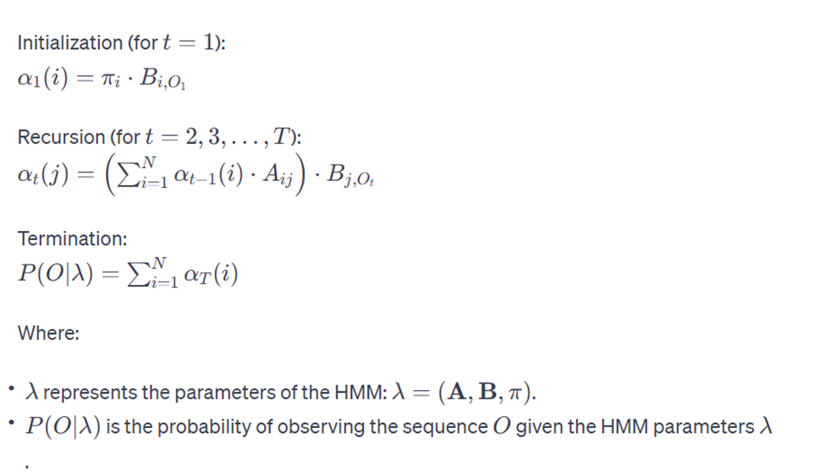
Forward Algorithm
Let αt​(i) denote the forward probability at time t for being in state i and observing the sequence 1,2,…,O1​,O2​,…,Ot​. The forward algorithm computes these probabilities recursively as follows:

Slide 9
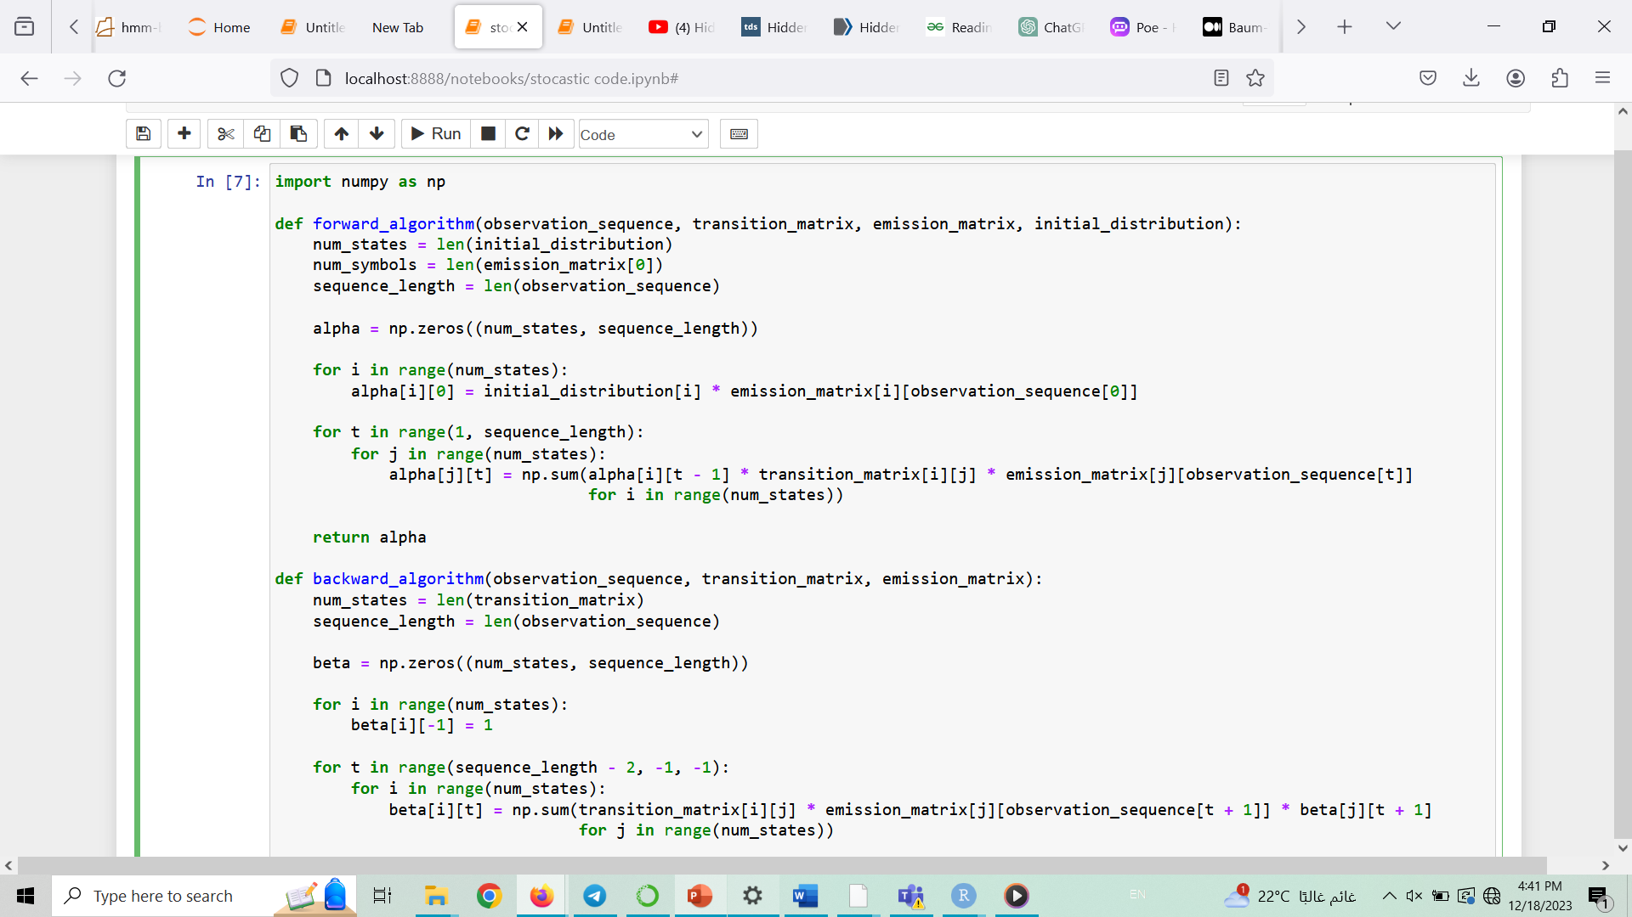
Forward Algorithm

Slide 10
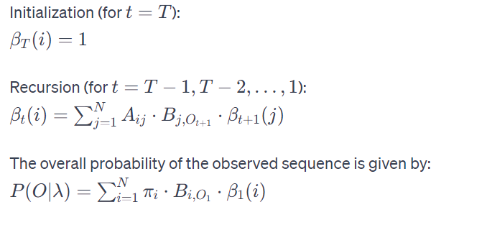
Backward Algorithm
The backward algorithm is another dynamic programming algorithm is used to calculate the probability of observing a sequence of observations from a Hidden Markov Model (HMM) given a particular state sequence. The algorithm is used in conjunction with the forward algorithm to calculate the probability of a particular state sequence given a sequence of observations.
Let's define some notation before presenting the equations:

Slide 11
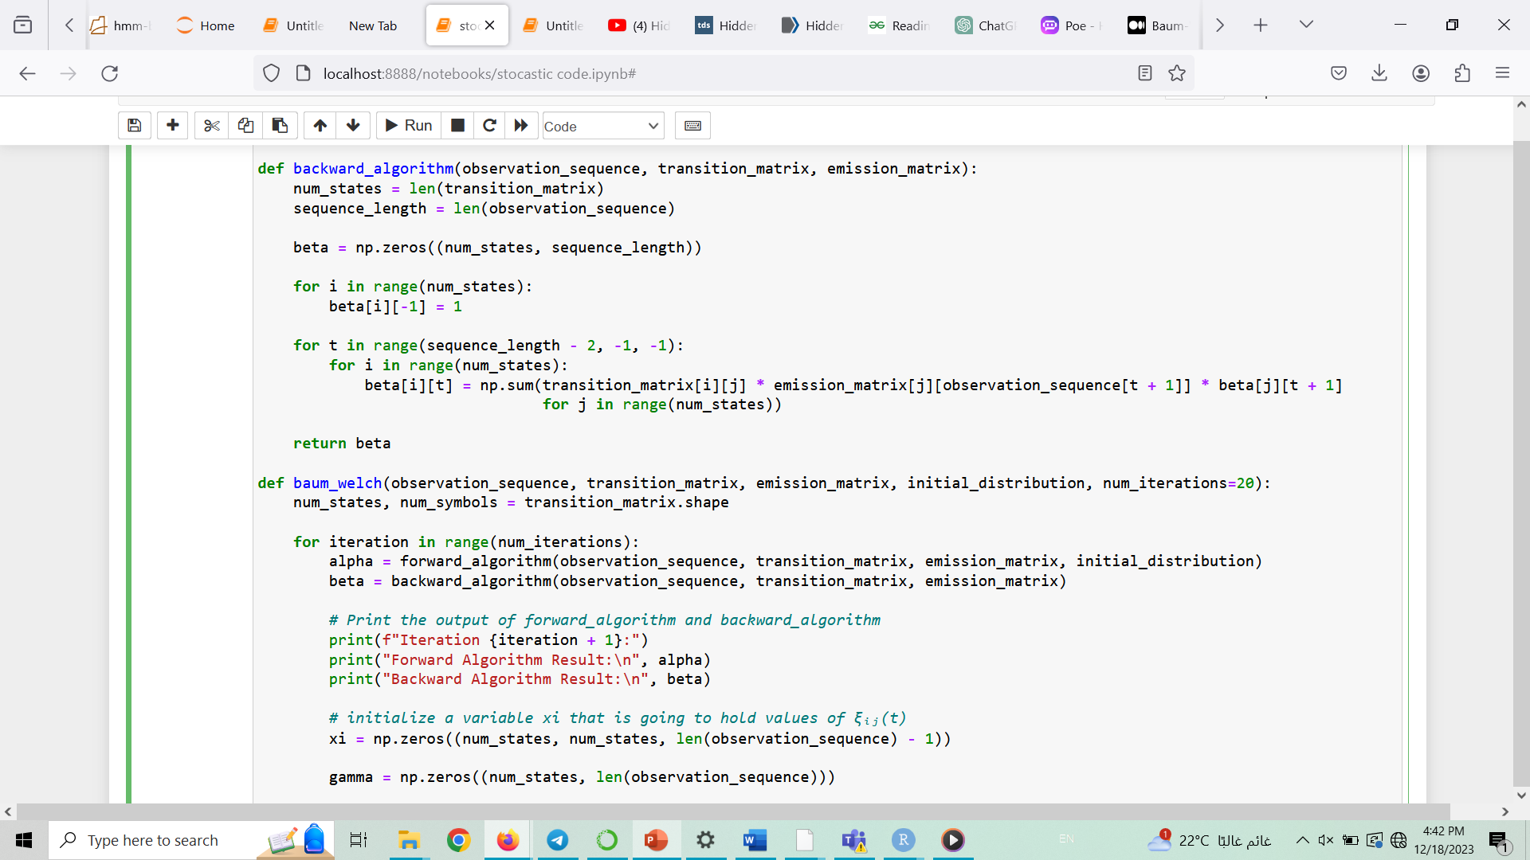
Backward Algorithm

Slide 12
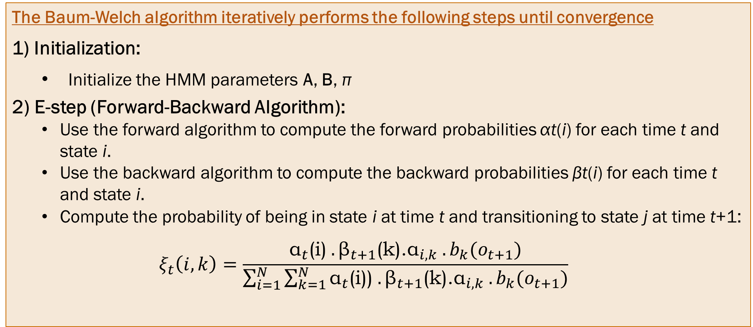
Baum welch Algorithm
The Baum-Welch algorithm iteratively performs the following steps until convergence
Initialization:
Initialize the HMM parameters A, B, π
2) E-step (Forward-Backward Algorithm):
Use the forward algorithm to compute the forward probabilities αt​(i) for each time t and state i.
Use the backward algorithm to compute the backward probabilities βt​(i) for each time t and state i.
Compute the probability of being in state i at time t and transitioning to state j at time t+1:
$$ξ_{t}\left(i,k\right)=\frac{{\text{α}}_{t}\text{(}\text{i}\text{)} .{\text{β}}_{t+1}\text{(}\text{k}\text{)}\text{.}{\text{α}}_{i,k} .b_{k}(o_{t+1})}{\sum_{i=1}^{N}{\sum_{k=1}^{N}{{\text{α}}_{t}\text{(}\text{i}\text{))} .{\text{β}}_{t+1}\text{(}\text{k}\text{)}\text{.}{\text{α}}_{i,k} .b_{k}(o_{t+1})}}}$$

Slide 13
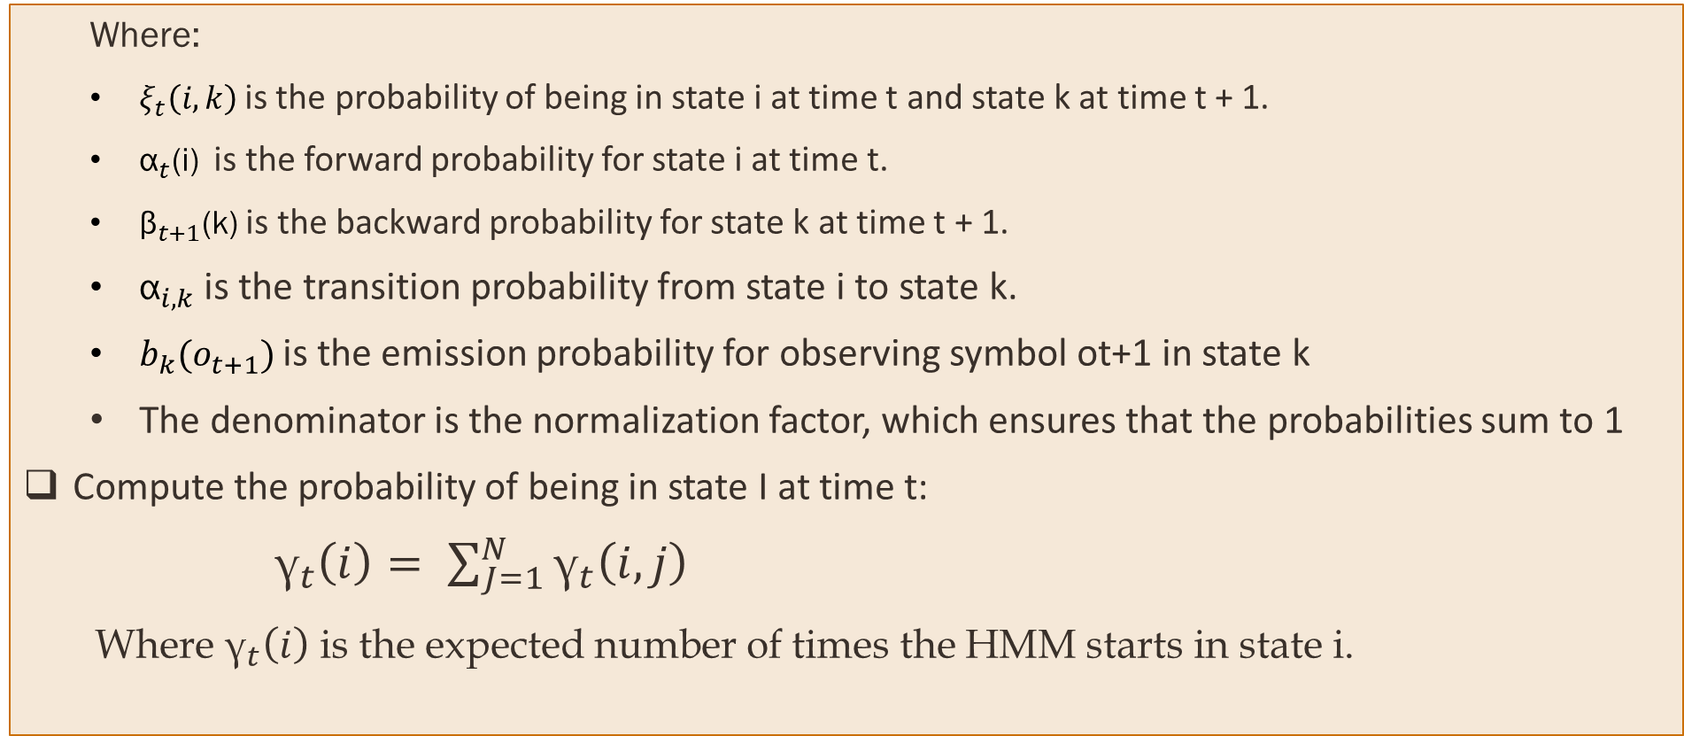
Baum welch Algorithm
Where:
$ξ_{t}\left(i,k\right)$is the probability of being in state i at time t and state k at time t + 1.
${\text{α}}_{t}\text{(}\text{i}\text{)}$ is the forward probability for state i at time t.
${\text{β}}_{t+1}\text{(}\text{k}\text{)}$ is the backward probability for state k at time t + 1.
${\text{α}}_{i,k}$ is the transition probability from state i to state k.
$b_{k}(o_{t+1})$is the emission probability for observing symbol ot+1 in state k
The denominator is the normalization factor, which ensures that the probabilities sum to 1
Compute the probability of being in state I at time t:
${\text{γ}}_{t}\left(i\right)= \sum_{J=1}^{N}{{\text{γ}}_{t}\left(i,j\right)}$
Where ${\text{γ}}_{t}\left(i\right)$ is the expected number of times the HMM starts in state i.

Slide 14
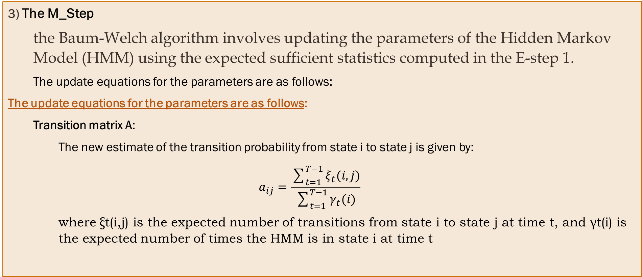
Baum welch Algorithm
3) The M_Step
the Baum-Welch algorithm involves updating the parameters of the Hidden Markov Model (HMM) using the expected sufficient statistics computed in the E-step 1.
The update equations for the parameters are as follows:
The update equations for the parameters are as follows:
Transition matrix A:
The new estimate of the transition probability from state i to state j is given by:
$$a_{ij}=\frac{\sum_{t=1}^{T−1}{ξ_{t}(i,j)}}{\sum_{t=1}^{T−1}{γ_{t}(i)}}$$
where ξt(i,j) is the expected number of transitions from state i to state j at time t, and γt(i) is the expected number of times the HMM is in state i at time t

Slide 15
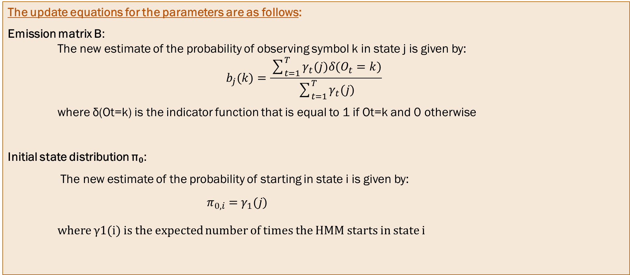
Baum welch Algorithm
The update equations for the parameters are as follows:
Emission matrix B:
The new estimate of the probability of observing symbol k in state j is given by:
$$b_{j}(k)=\frac{\sum_{t=1}^{T}{γ_{t}(j)δ(O_{t}=k)}}{\sum_{t=1}^{T}{γ_{t}(j)}}$$
where δ(Ot​=k) is the indicator function that is equal to 1 if Ot​=k and 0 otherwise
Initial state distribution π₀:
The new estimate of the probability of starting in state i is given by:
$π_{0,i}=$ $γ_{1}(j)$
where γ1​(i) is the expected number of times the HMM starts in state i

Slide 16
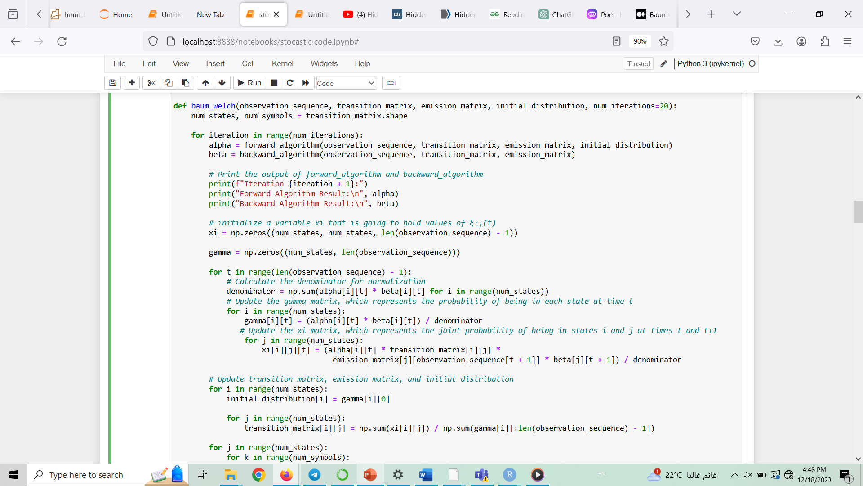
Baum welch Algorithm

Slide 17
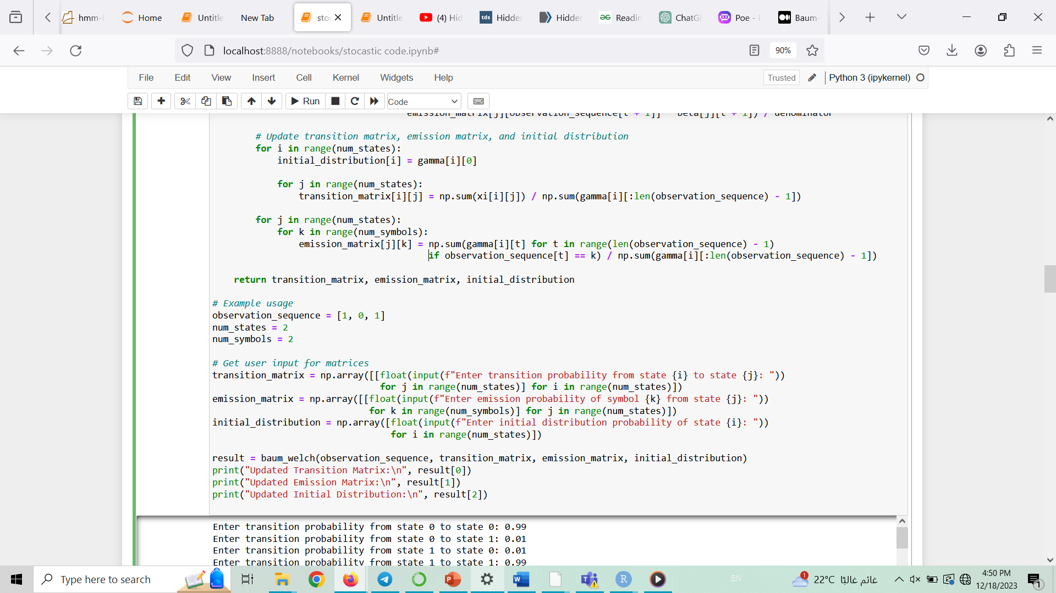
Baum welch Algorithm

Slide 18
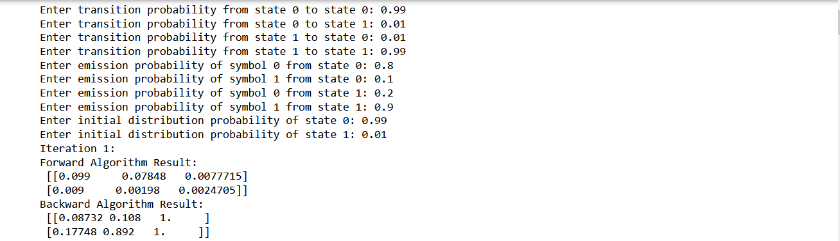
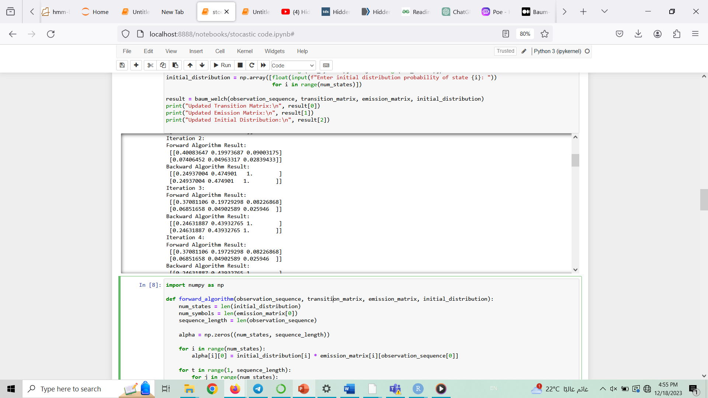
Baum welch Algorithm

Slide 19
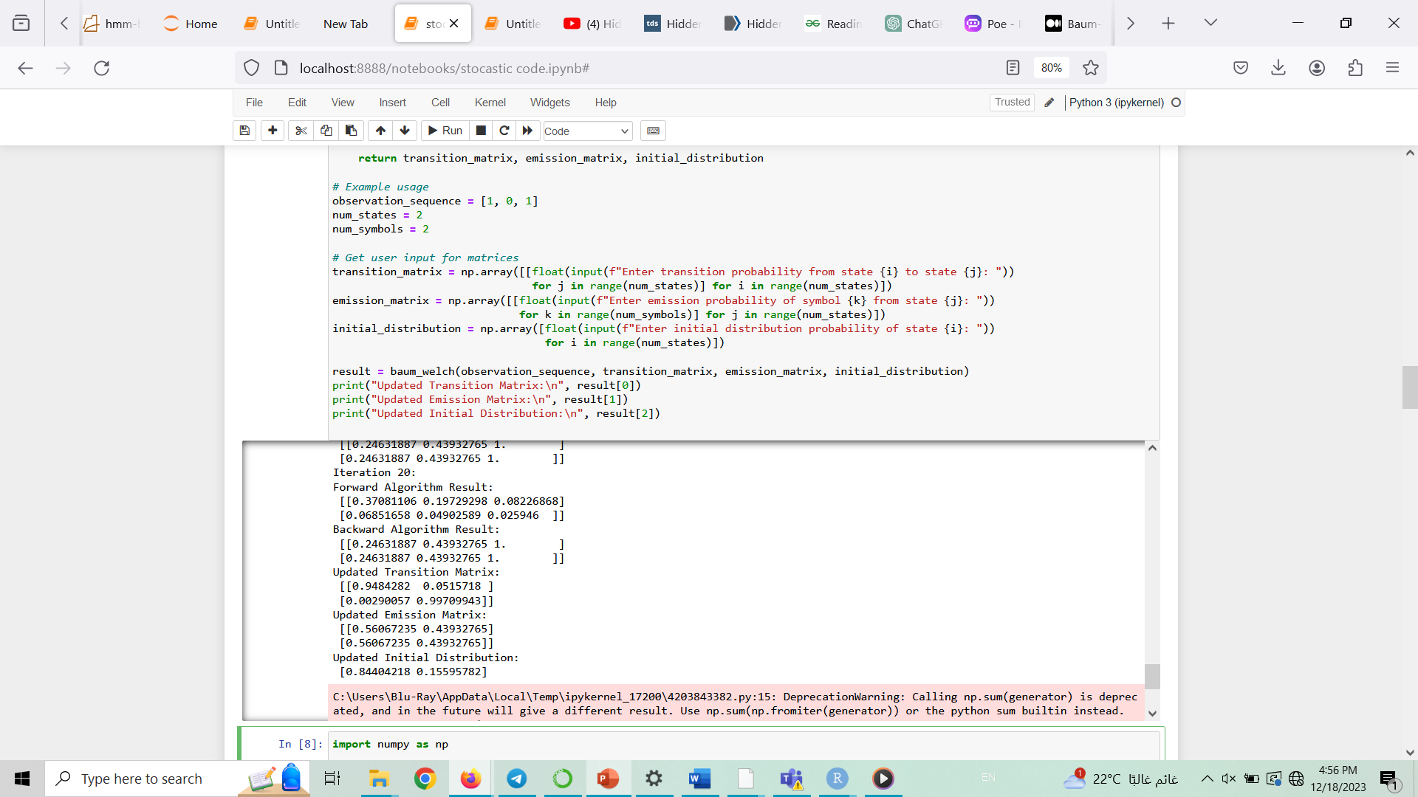
Baum welch Algorithm

